Slide 1
TEKS 9A & 9C
Gas Laws

Slide 2
Kinetic molecular theory Postulates Summarized to describe ideal gases
Ideal gas particles are of negligible size compared to the space between them.
The particles are in continuous, rapid, random motion.
Their collisions are elastic.
There are no significant interactions between particles of a gas.
When temperature increases for an ideal gas, the kinetic energy of the particles increases proportionally.

Slide 3
Units of Temp, volume, pressure
The temperature of a gas must always be expressed in Kelvin.
Convert degrees Celsius to Kelvin by adding 273.
Volume is expressed in L or mL
Pressure may be expressed in atmospheres (atm), millimeters of mercury (mm Hg), kilopascals (kPa) or pounds per square inch (psi)
1 atm = 760 mm Hg = 101.3 kPa = 14.7 psi
STP is Standard Temperature and Pressure
Standard Temperature is 273 K
Standard Pressure is 1 atmosphere

Slide 4
Converting units of pressure:
1 atm = 760 mmHg = 14.7 psi = 101.3 kPa = 760 torr
Let’s work some sample conversions together:
56 atm = _____ kPa
350 kPa = ______ mmHg
1400 mmHg = _______ atm

Slide 5
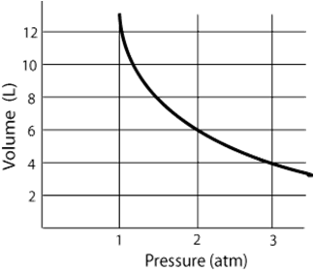
Boyle’s law & Equation
The pressure exerted by gas particles is inversely proportional to the volume occupied by the gas.
At a constant temperature, an increase in pressure will result in a decrease in volume.
The equation is P₁V₁ = P₂V₂ where P₁V₁ represents an initial set of pressure and volume conditions and P₂V₂ represents a new set of conditions.
The graph shows what the inverse relationship looks like.

Slide 6
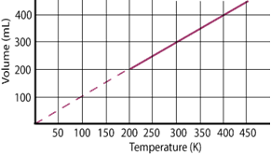
Charles’ law & Equation
The temperature of a gas is directly proportional to the volume occupied by the gas.
When the pressure is held constant, a decrease in temperature results in a decrease in volume.
The equation for Charles’ Law is V₁/T₁ = V₂/T₂ where V₁/T₁ represents initial volume and temp conditions and V₂/T₂ represents a new set of conditions.
The graph shows what the direct relationship looks like

Slide 7
Gay-Lussac’s law
The ratio of pressure to temperature of a gas at fixed volume is constant.
The pressure of a gas is directly proportional to the temperature at a fixed volume.
The equation for Gay-Lussac’s Law is P₁/T₁ = P₂/T₂

Slide 8
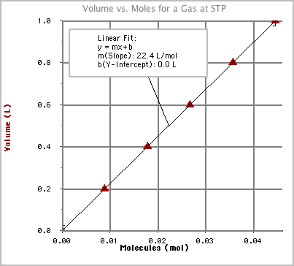
Avogadro’s law
Establishes the relationship between number of moles (represented in the equation as the variable n) and the volume occupied by the gas at a constant temperature and pressure.
The volume of the a gas is directly proportional to the number of moles of a gas.
The equation for Avogadro’s Law is V1/n1 = V2/n2
Avogadro’s Principle states that equal volumes of gases contain the same number of atoms or particles.
The graph shows the direct relationship between volume and moles

Slide 9
Dalton’s law of partial pressures
States that the total pressure exerted by a mixture of gases is equal to the sum of the individual pressures of all the gases in the mixture.
Dalton’s Law of Partial Pressures can be described by the equation P_{Total}=P₁+P₂+P₃+P₄……. Where P_{Total} represents the combined pressure of the mixture of gases and P₁, P₂, P₃ represent the individual gases.

Slide 10
The ideal gas law
Describes the relationship between the temperature, pressure, volume and number of moles of a gas under specific conditions.
The Ideal Gas Law Equation is PV = nRT, where P is pressure, V is volume, n is number of moles, R is the ideal gas constant and T is temperature
The ideal gas constant is a physical constant and is specific to the units used for pressure and volume measurements.
The values for R can be found on the formula chart.

