Slide 1
Material Safety Data Sheets
Interpreting and Understanding Information on a MSDS

Slide 2
Requirements: Material Safety Data Sheets
• MSDS for hazardous chemicals must be in workplace
• employees must be able to interpret MSDS information
• MSDS may be in printed form or available electronically
• MSDS that is missing must be replaced within 30 days
• Hazardous chemicals may not be used if a MSDS is not available
• MSDS shall be readily available for review by employees

Slide 3
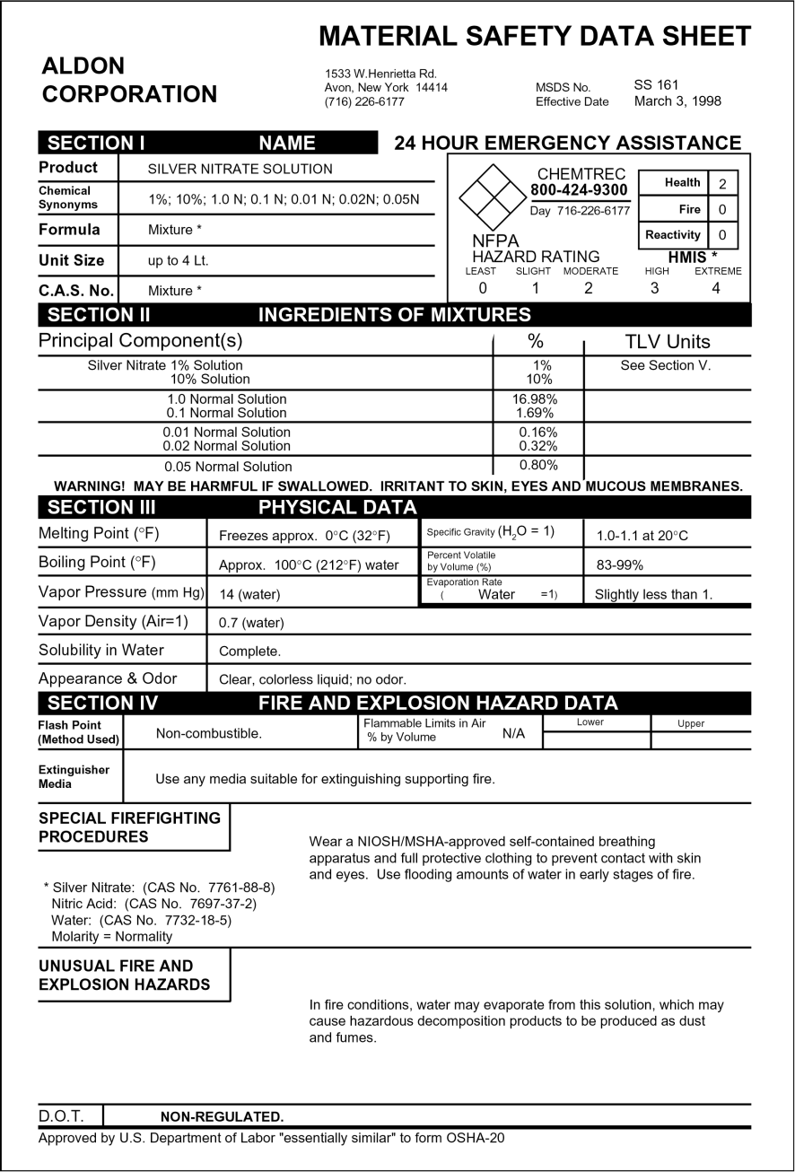
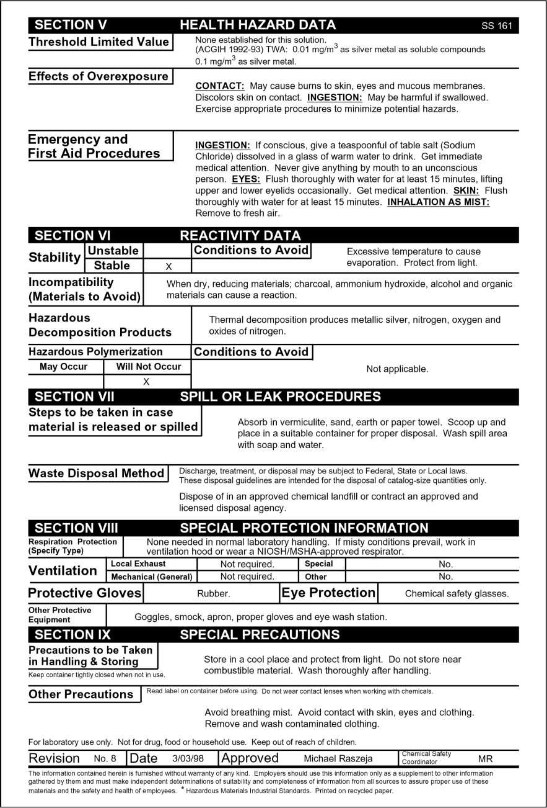
Material Safety Data Sheet (MSDS)

Slide 4
Silver Nitrate MSDS
*HMIS (Hazardous Materials Industrial Standards)

Slide 5
Silver Nitrate MSDS

Slide 6
Silver Nitrate MSDS

Slide 7
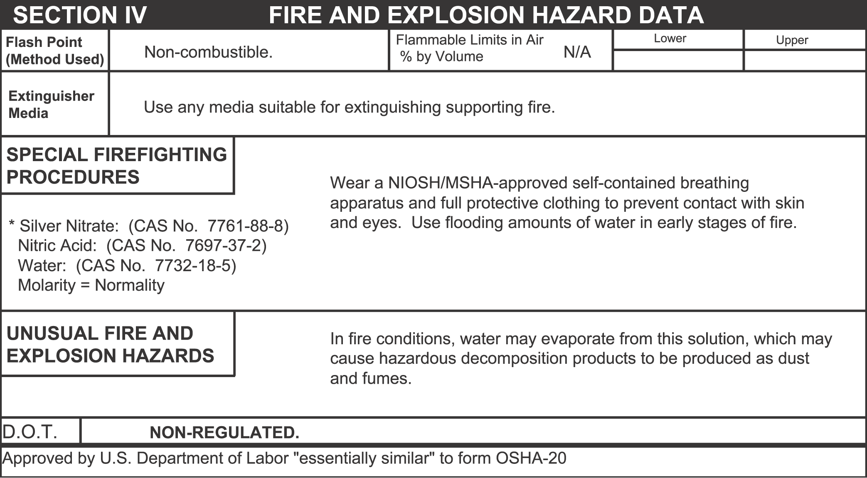
Silver Nitrate MSDS

Slide 8
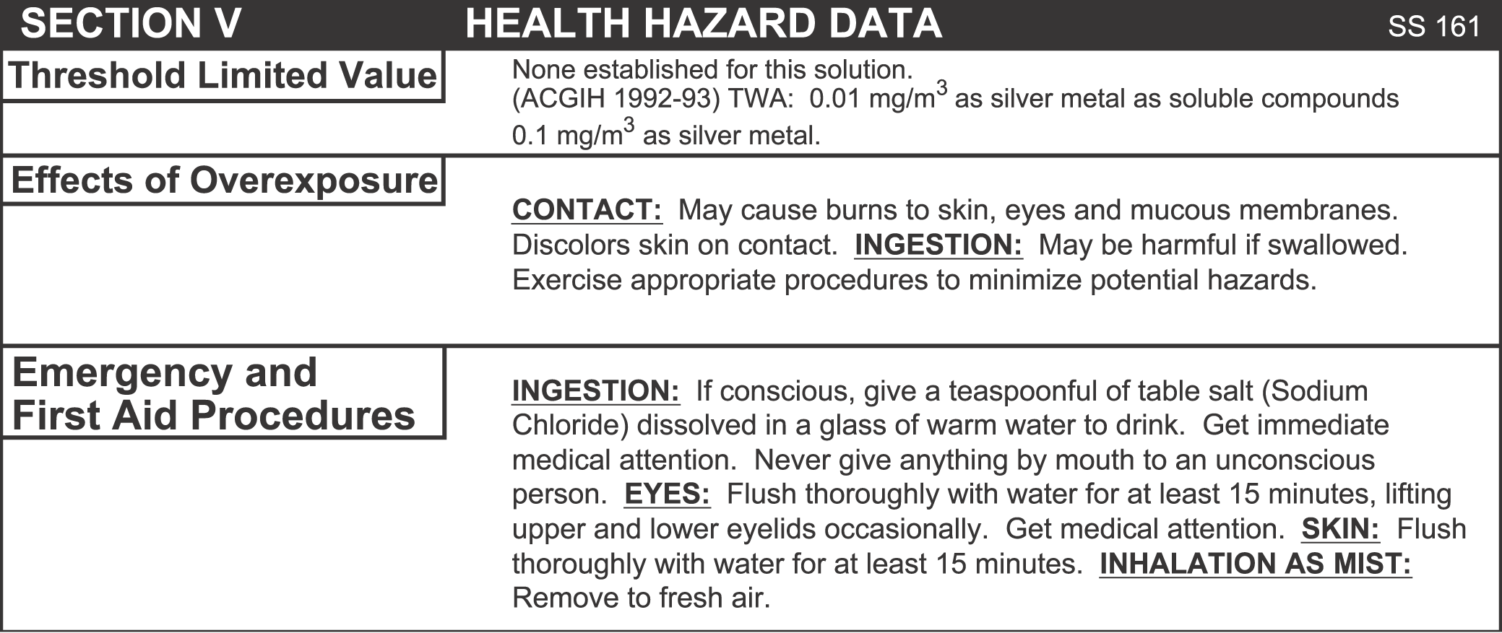
Silver Nitrate MSDS

Slide 9
Silver Nitrate MSDS

Slide 10
Silver Nitrate MSDS

Slide 11
Silver Nitrate MSDS

Slide 12
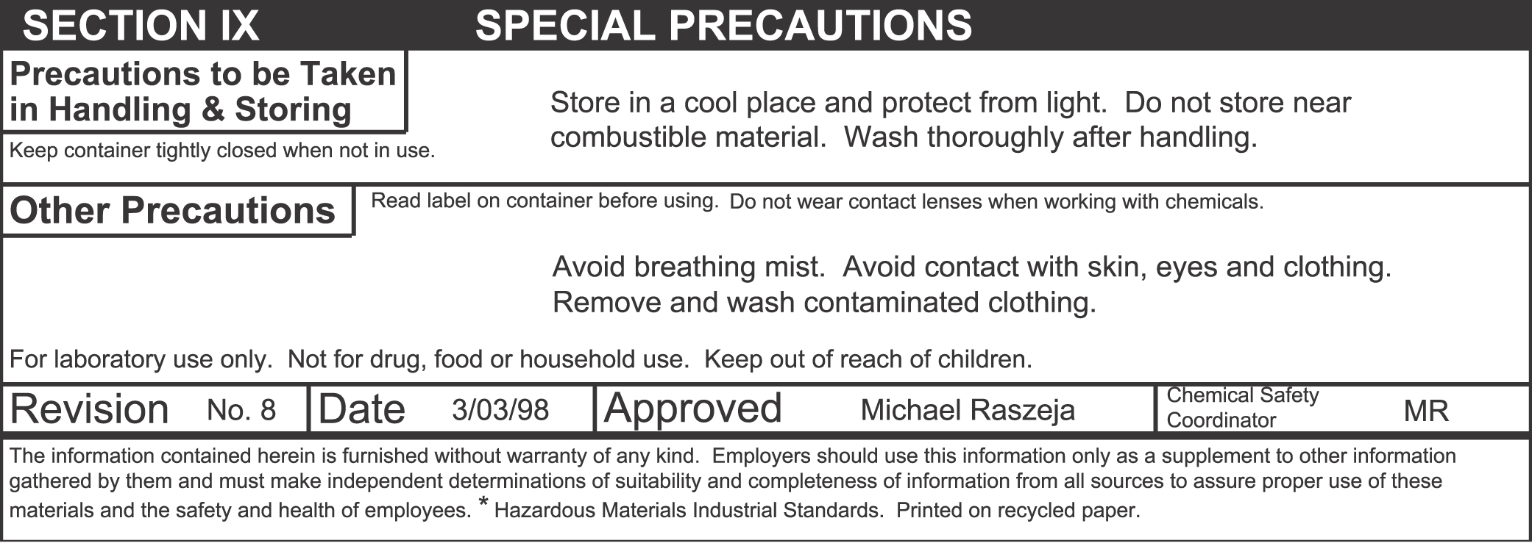
Silver Nitrate MSDS

Slide 13
National Fire Protection Association (NFPA) Hazard Rating Diamond

Slide 14
NFPA Diamond

Slide 15
Health Hazard
Flammability Hazard
3
0
1
Reactivity
Hazard
OX
Special Hazard

Slide 16
Hazard Rating
Severe
Serious
Dangerous
Minor
0 Slight

Slide 17
What does this NFPA Diamond mean?
3
2
4
W

Slide 18
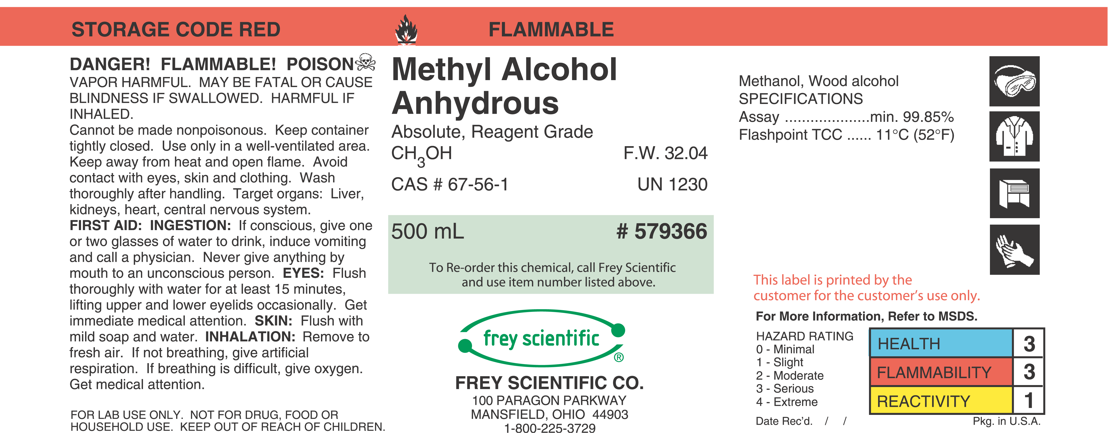
Hazard Class & Packing Number
Identity of Chemical
Hazard Warning
Hazard Signage/ Specifications
Chemical Abstract Number
Formula Weight
Hazard Rating
First Aid
24 hour contact number
Date Received
Manufacturer /Distributor

